Slide 1
Displaying Tweets with P5.js
Continued from previous tutorial on Twitter, HealthKit, and Firebase
From here: https://github.com/iDataVisualizationLab/CS3366/blob/master/slides/TwitterHealthKitFirebase.pptx

Slide 2
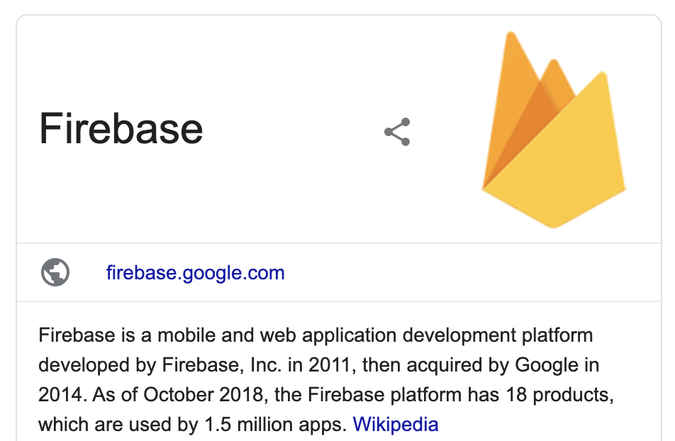
From previous tutorial
authenticate
health information
CordovaHealth
authenticate
authenticate
health information
Your App GUI
rq. tweets
codebird.js (consumer keys + cors)
rp. tweets
Access token, secret
rp. tweets
rq. tweets
rq. tweets
Twitter Feed Service (Node.js)
rp. tweets

Slide 3
This tutorial
Adding p5.js to our project
Displaying tweets in a draggable object on our mirror

Slide 4
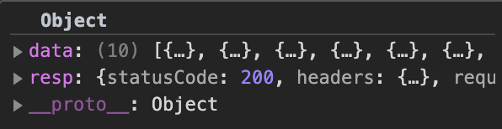
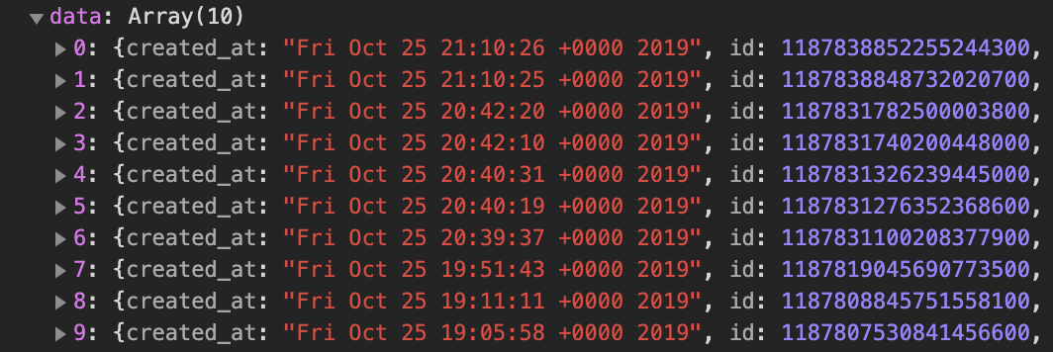
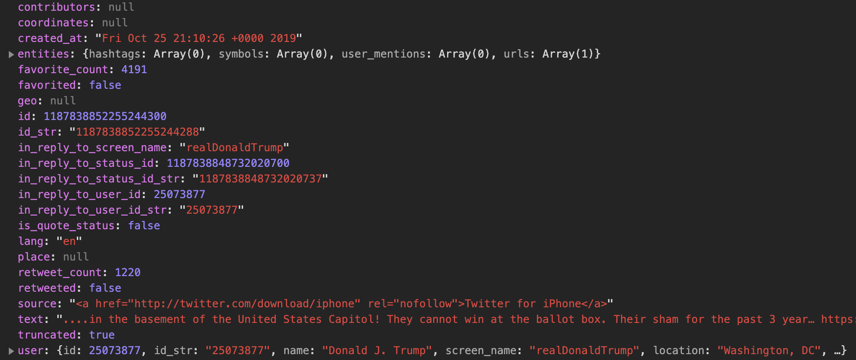
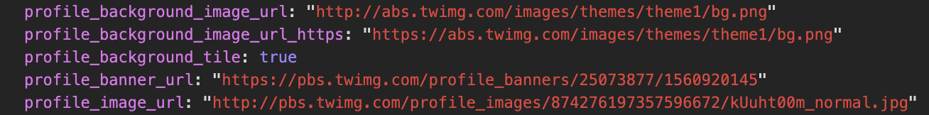
Tweet structure (1/2)

Slide 5

Tweet structure (2/2)
Tweet object contains
data which is an array of loaded tweets
resp which contains HTTP response information
An individual tweet in data contains many fields, but these are important ones
text is the tweet content
user contains the user’s information of the tweet
The user field contains several fields, but we are interested in
profile_image_url which is the URL to the user’s profile image

Slide 6
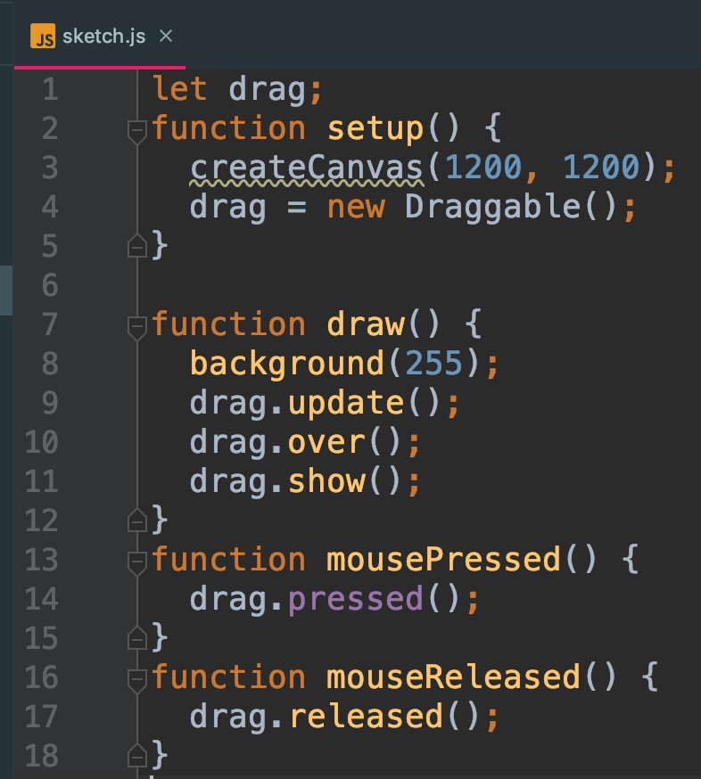
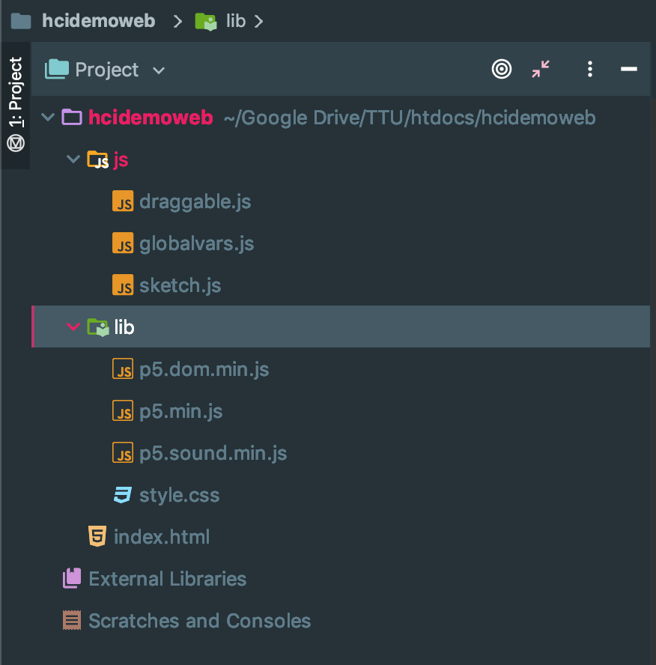
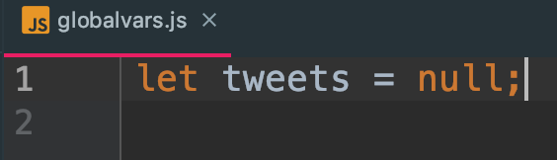
Adding p5.js to our hcidemoweb project
We used to store tweets object loaded from index.html and to be displayed in the p5.js canvas.
These are files from p5.js website:
https://github.com/processing/p5.js/releases/download/0.10.2/p5.zip
Follow this tutorial for further details:
https://github.com/iDataVisualizationLab/CS3366/blob/master/slides/P5jsandHTML.pptx

Slide 7
Update index.html to parse tweets
Add these for p5.js
Update this method to parse the tweet content and load image for the user profile
Note: should load the actual profile image at this step, not at the draw() method of p5.js.

Slide 8
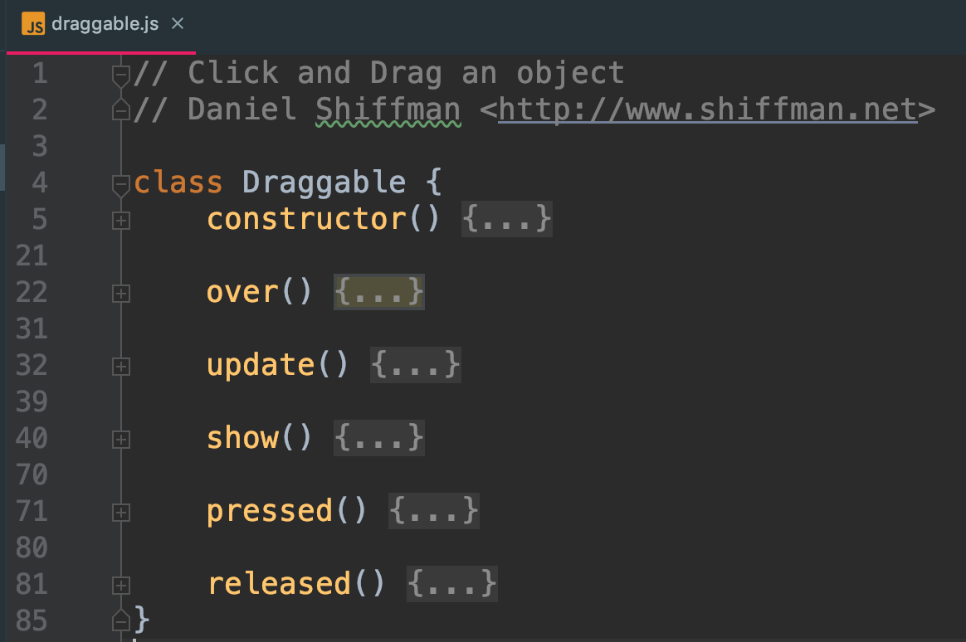
Draggable class
You can try it from here: https://editor.p5js.org/projects/B13wH5T3
These are for dragging functionality:
over()
update()
pressed()
released()
(Just accept these as default)
We will focus on
constructor(): initialization
show(): visualization code

Slide 9
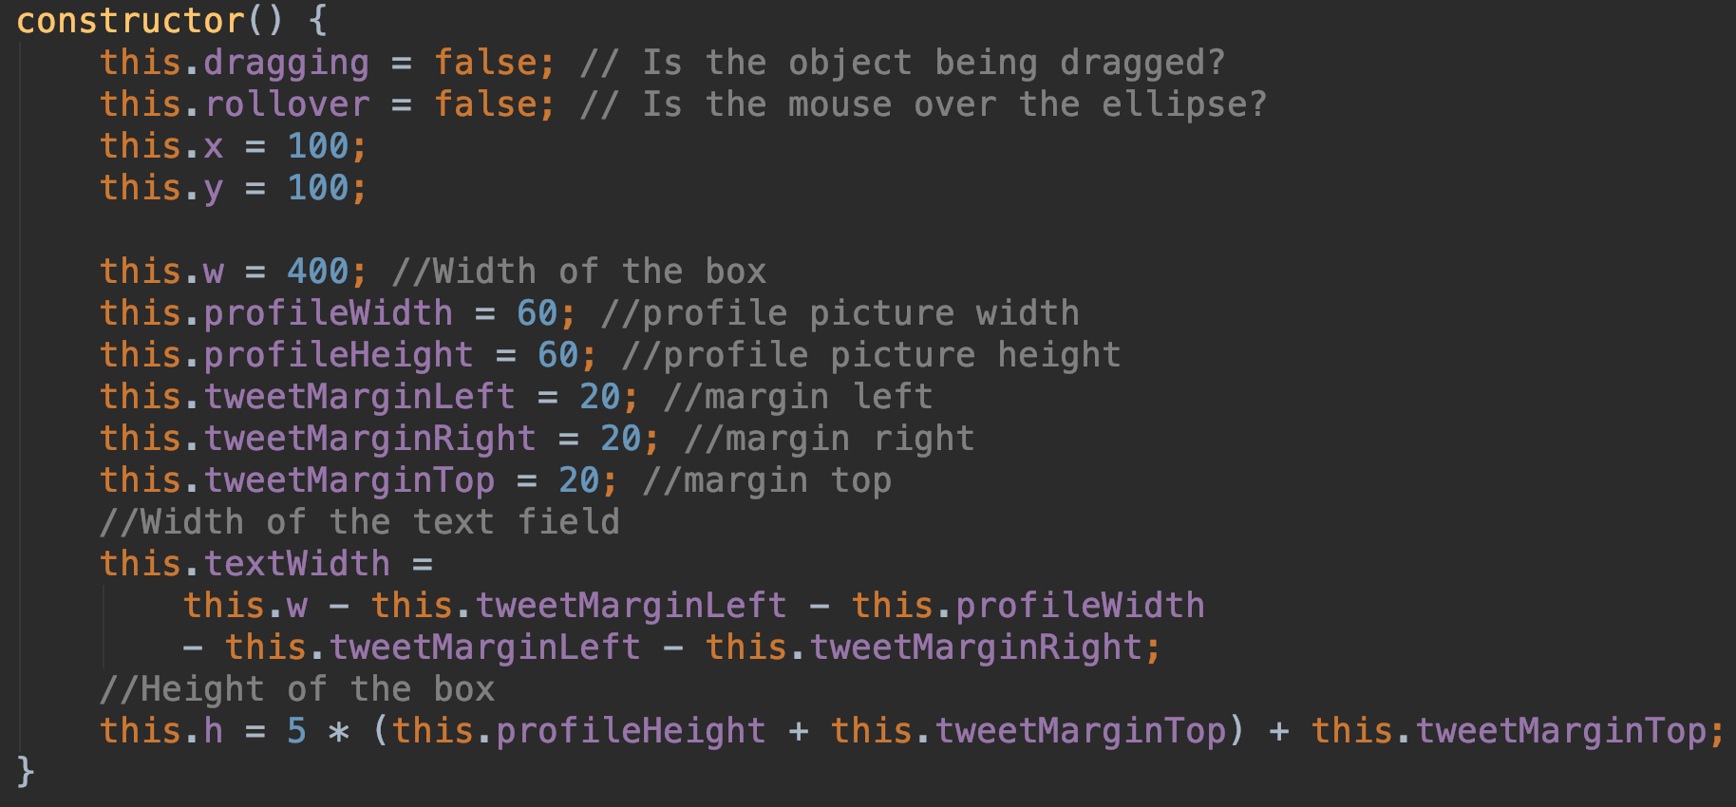

Draggabale constructor
5 is currently maximum number of tweets to be displayed

Slide 10
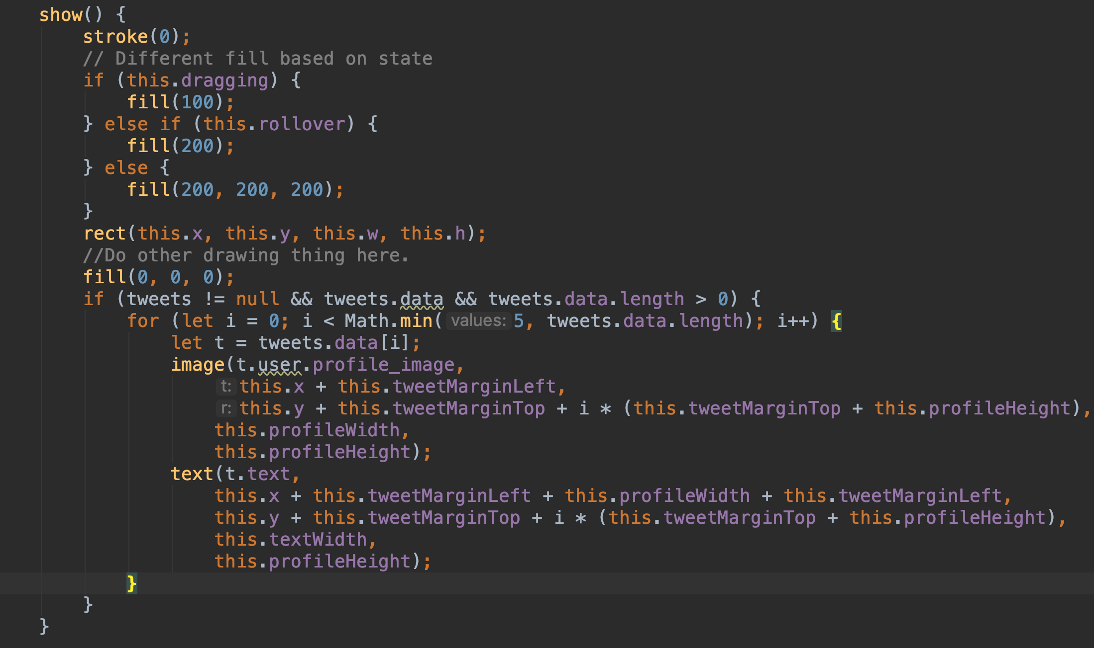
The show() method from Draggable
For the background rectangle
For the display of our tweets

Slide 11
Test
Run command: node server.js to start hcidemonodejs server
Run our website (hcidemoweb) and allows pop-up for Twitter authentication
Click on load tweets button to load tweets
Try to drag and move the rectangle

